Slide 1

INSTITUTE - UIE
DEPARTMENT- ACADEMIC UNIT-2
Bachelor of Engineering (Computer Science & Engineering)
Subject Name: Introduction to Problem Solving
Code:22CSH-101
Pointers: Basics
DISCOVER . LEARN . EMPOWER

Slide 2


Introduction to Problem Solving
Course Objectives
The course aims to provide exposure to problem-solving through programming.
The course aims to raise the programming skills of students via logic building capability.
With knowledge of C programming language, students would be able to model real world problems.

Slide 3



Course Outcomes
CO Number | Course Outcome
CO1 | Remember the concepts related to fundamentals of C language, draw flowcharts and write algorithm/pseudocode.
CO2 | Understand the way of execution and debug programs in C language.
CO3 | Apply various constructs, loops, functions to solve mathematical and scientific problem.
CO4 | Analyze the dynamic behavior of memory by the use of pointers.
CO5 | Design and develop modular programs for real world problems using control structure and selection structure.

Slide 4
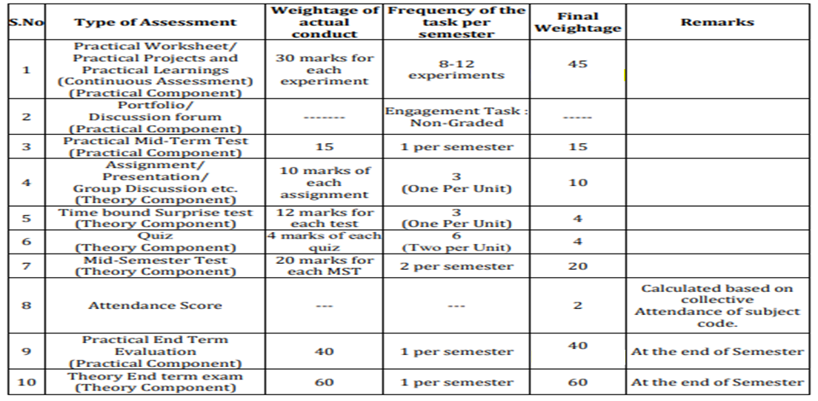
Scheme of Evaluation

Slide 5
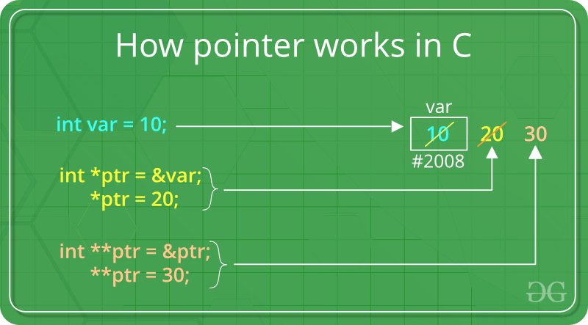
Introduction
POINTER is a variable that stores address of another variable.
A pointer can also be used to refer to another pointer function.
A pointer can be incremented/decremented, i.e., to point to the next/ previous memory location.
The purpose of pointer is to save memory space and achieve faster execution time.
Source: https://www.geeksforgeeks.org/double-pointer-pointer-pointer-c/

Slide 6
Features of Pointers
Pointers save memory space.
Execution time with pointers is faster because data are manipulated with the address, that is, direct access to
memory location.
Memory is accessed efficiently with the pointers. The pointer assigns and releases the memory as well. Hence it can be said the Memory of pointers is dynamically allocated.
Pointers are used with data structures. They are useful for representing two-dimensional and multi-dimensional
arrays.
An array, of any type can be accessed with the help of pointers, without considering its subscript range.
Pointers are used for file handling.
Pointers are used to allocate memory dynamically.
In C++, a pointer declared to a base class could access the object of a derived class. However, a pointer to a derived class cannot access the object of a base class.

Slide 7
Declaring a pointer
Like variables, pointers have to be declared before they can be used in your program.
Pointers can be named anything you want as long as they obey C's naming rules.
A pointer declaration has the following form.
data_type * pointer_variable_name;
Here,
data_type is the pointer's base type of C's variable types and indicates the type of the variable that the pointer points to.
The asterisk (*: the same asterisk used for multiplication) which is indirection operator, declares a pointer.

Slide 8
Initialize a pointer
After declaring a pointer, we initialize it like standard variables with a variable address.
If pointers are not uninitialized and used in the program, the results are unpredictable and potentially disastrous.
To get the address of a variable, we use the ampersand (&)operator, placed before the name of a variable whose address we need.
Pointer initialization is done with the following syntax:
pointer = &variable;

Slide 9
Example:
#include <stdio.h>
int main()
{
int a=10; //variable declaration
int *p; //pointer variable declaration
p=&a; //store address of variable a in pointer p
printf("Address stored in a variable p is:%x\n",p); //accessing the address
printf("Value stored in a variable p is:%d\n",*p); //accessing the value
return 0;
}
Output:
Address stored in a variable p is:60ff08
Value stored in a variable p is:10

Slide 10
Operators used with Pointers
Operator | Meaning
* | Serves 2 purposeDeclaration of a pointer Returns the value of the referenced variable
& | Serves only 1 purpose Returns the address of a variable

Slide 11
Types of a pointer
Null pointer
We can create a null pointer by assigning null value during the pointer declaration. This method is useful when you do not have any address assigned to the pointer. A null pointer always contains value 0.
Following program illustrates the use of a null pointer:
#include <stdio.h>
int main()
{
int *p = NULL; //null pointer
printf(“The value inside variable p is:\n%x”,p);
return 0;
}
Output:
The value inside variable p is:
0

Slide 12
2. Void Pointer
In C programming, a void pointer is also called as a generic pointer. It does not have any standard data type. A void pointer is created by using the keyword void. It can be used to store an address of any variable.
Following program illustrates the use of a void pointer:
#include <stdio.h>
int main()
{
void *p = NULL; //void pointer
printf("The size of pointer is:%d\n",sizeof(p));
return 0;
}
Output:
The size of pointer is:4

Slide 13
3. Wild pointer
A pointer is said to be a wild pointer if it is not being initialized to anything. These types of pointers are not efficient because they may point to some unknown memory location which may cause problems in our program and it may lead to crashing of the program. One should always be careful while working with wild pointers.
Following program illustrates the use of wild pointer:
#include <stdio.h>
int main()
{
int *p; //wild pointer
printf("\n%d",*p);
return 0;
}
Output:
timeout: the monitored command dumped core
sh: line 1: 95298 Segmentation fault timeout 10s main

Slide 14
Uses of pointers
To pass arguments by reference
For accessing array elements
To return multiple values
Dynamic memory allocation
To implement data structures
To do system level programming where memory addresses are useful

Slide 15
Disadvantages of pointer
Uninitialized pointers might cause segmentation fault.
Dynamically allocated block needs to be freed explicitly.
If pointers are updated with incorrect values, it might lead to memory corruption.

Slide 16
Summary
A pointer can also be used to refer to another pointer function.
POINTER is a variable that stores address of another variable.
A pointer can be incremented/decremented, i.e., to point to the next/ previous memory location.
Memory is accessed efficiently with the pointers.
The purpose of pointer is to save memory space and achieve faster execution time.

Slide 17
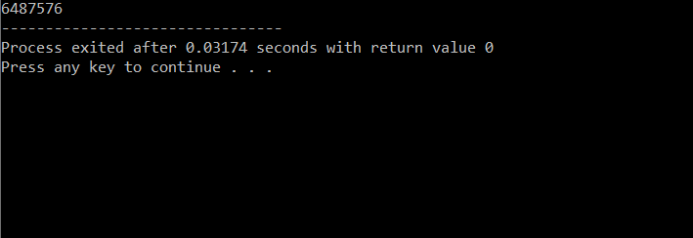
Frequently Asked question
Q1:2) What will be the output of the C program?
#include<stdio.h>
int main(){
int i = 3;
int *j;
j = &i;
j++;
printf("%d ",*j);
return 0;
}
Output:

Slide 18
2) What will be the output of the C program?
#include<stdio.h>
int main(){
int a = 130;
char *ptr;
ptr = (char *)&a;
printf("%d ",*ptr);
return 0;
}
Ans : -126

Slide 19
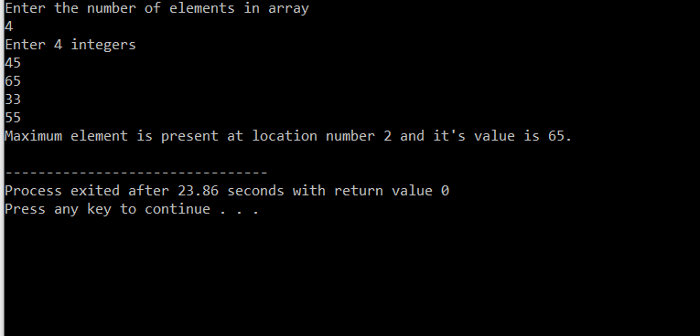
Output:

Slide 20
Q3) What is “&” and “*” operators in C?
Ans:
1. “*” Operator is used as pointer to a variable. Example: * a where * is pointer to the variable a.
& operator is used to get the address of the variable. Example: &a will give address of a.
Q4) WHAT IS VOID POINTER IN C?
Ans:
Void pointer is a generic pointer that can be used to point another variable of any data type.
Void pointer can store the address of variable belonging to any of the data type. So, void pointer is also called as general purpose pointer.

Slide 21
Assessment Questions:
1. C Program to calculate Area of Circle using Pointer
2. Write a C Program to Swap Two Numbers / Variables using Pointer?
3. What will be the output of the C program?
#include<stdio.h>
#include<string.h>
int main(){
char *ptr = "hello";
char a[22];
strcpy(a, "world");
printf("\n%s %s",ptr, a);
return 0;
}

Slide 22

Discussion forum.
Other types of pointers in 'c' are as follows:
Dangling pointer
Complex pointer
Near pointer
Far pointer
Huge pointer
Write a program to count the number of words, lines and characters in a text using pointer

Slide 23

REFERENCES
Reference Books
[1] Programming in C by Reema Thareja.
[2] Programming in ANSI C by E. Balaguruswamy, Tata McGraw Hill.
[3] Programming with C (Schaum's Outline Series) by Byron Gottfried Jitender Chhabra, Tata McGraw Hill.
[4] The C Programming Language by Brian W. Kernighan, Dennis Ritchie, Pearson education.
Websites:
https://www.geeksforgeeks.org/features-and-use-of-pointers-in-c-c/
https://www.guru99.com/c-pointers.html
YouTube Links:
https://www.youtube.com/watch?v=sY-s7O0FiYE&t=3s
https://www.youtube.com/watch?v=qcWQ1AmmNWI&t=193s

Slide 24
THANK YOU

